Slide 1

AIRBNB HOTEL BOOKING ANALYSIS
Sk. Zaafira Yumn
INTERNSHIP_17546440516895be537820f

Slide 2

PROBLEM STATEMENT
Hospitality industry transforming rapidly
Airbnb’s unique commission model
NYC as a key market
Need insights on pricing & trends

Slide 3
PROJECT DESCRIPTION
NYC Airbnb dataset analysis
Data cleaning & visualization
Explore pricing & availability
Actionable insights for stakeholders

Slide 4

WHO ARE THE END USERS?
Hosts – to optimize pricing, availability, and property listings.
Guests – to make informed booking choices based on location and price trends.
Investors & Stakeholders – to understand market dynamics and growth opportunities.
Policy Makers & City Planners – to assess Airbnb’s impact on housing and tourism.
Researchers & Analysts – to study urban rental patterns and customer behavior.

Slide 5

TECHNOLOGY USED
Python – Core programming language
Pandas & NumPy – Data cleaning and preprocessing
Scikit-learn – Machine learning (model training, regression, evaluation)
Matplotlib/Seaborn – Data visualization and feature importance
Google Colab – Cloud-based environment for running the project
File handling libraries – openpyxl (for Excel) and built-in CSV handling

Slide 6
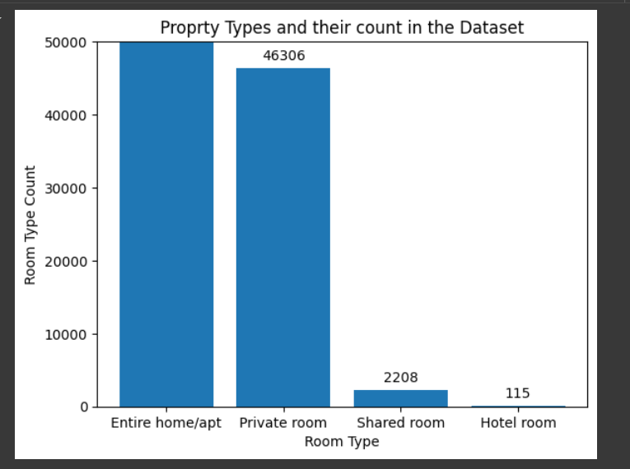
RESULT - 1

Slide 7
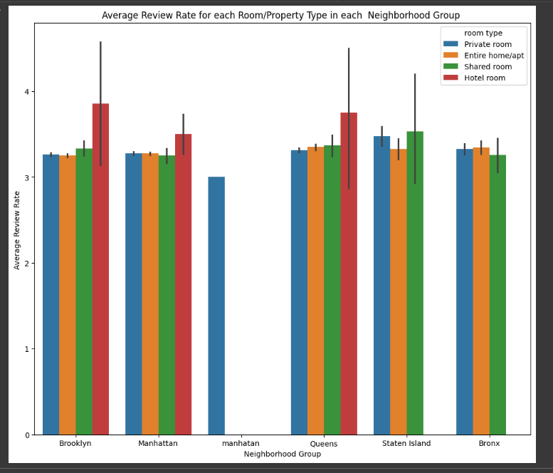
RESULT -2
Demo Link

Slide 8
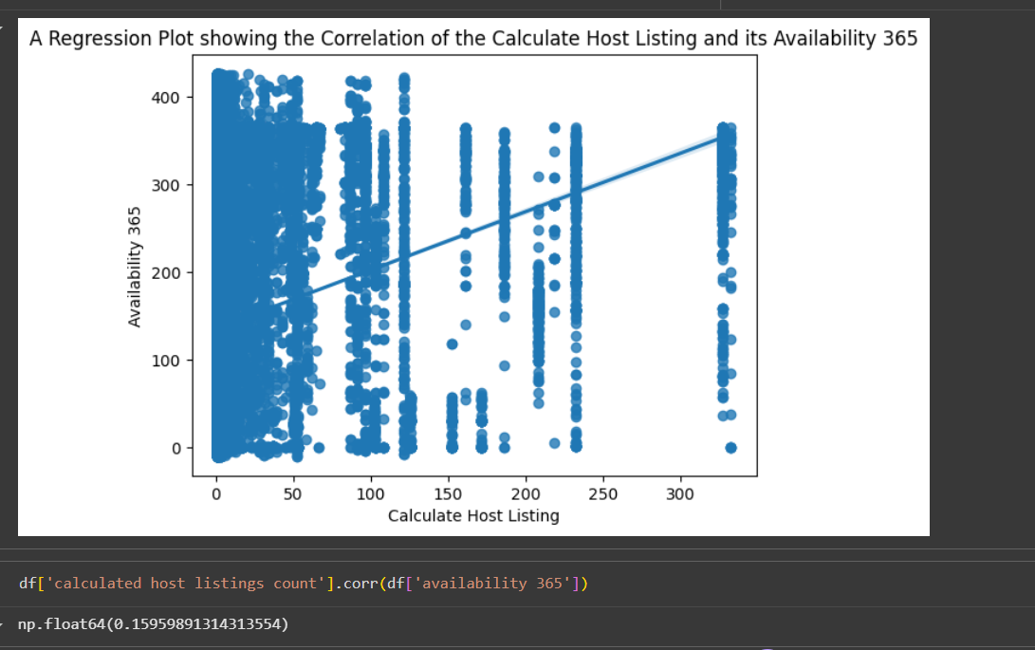
RESULT -3
Demo Link

Slide 9
GITHUB REPOSITORY
URL: https://github.com/zaafira12/VOIS_AICTE_Oct2025_Sk-Zaafira-Yumn.git
Demo Link

Slide 10
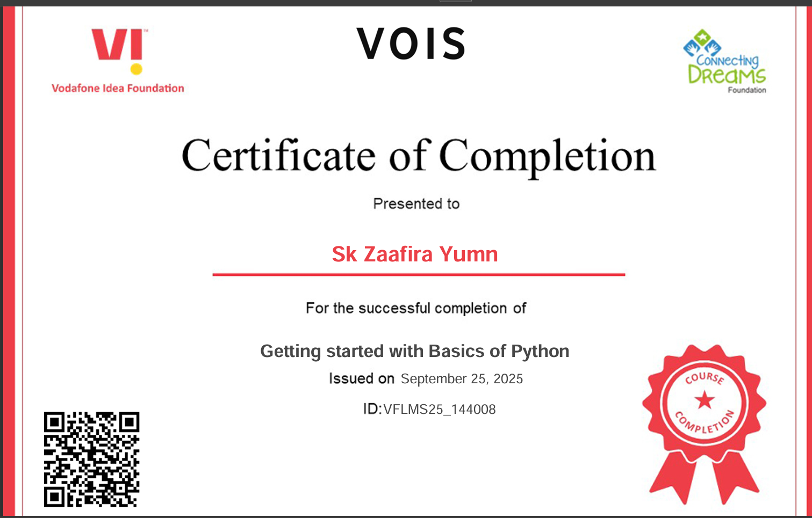
GETTING STARTED WITH BASICS OF PYTHON CERTIFICATE
[Paste your Certificate Here]

Slide 11
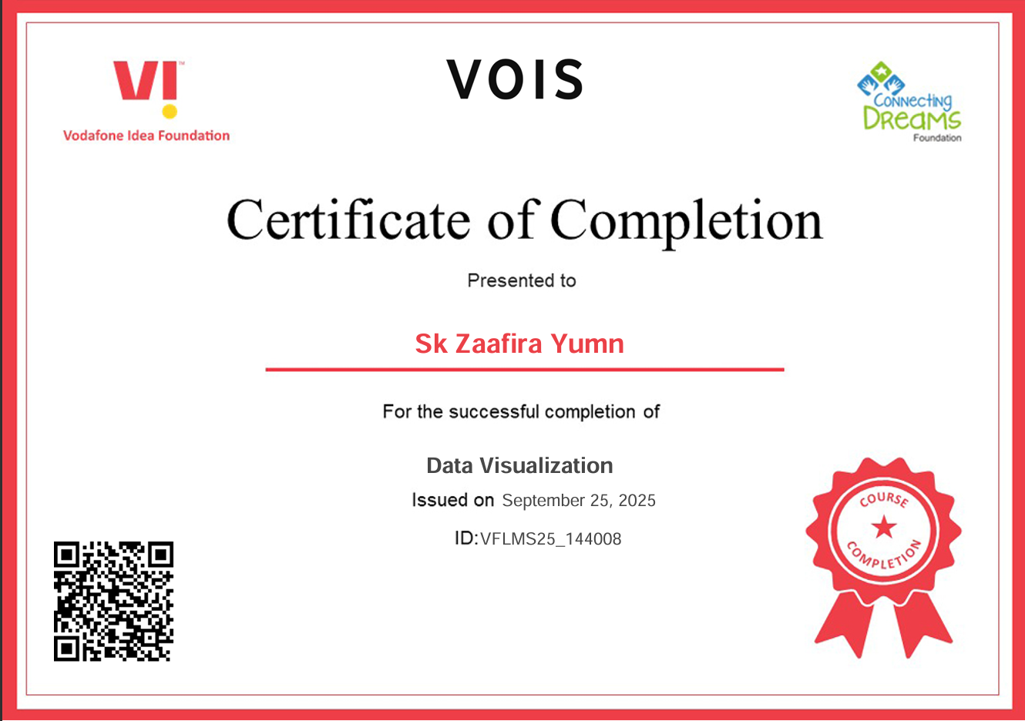
DATA VISUALIZATION CERTIFICATE

Slide 12
THANK YOU
.
.
.

